Slide 1
Market Failures
EXTERNALITIES & COMMON POOL/ACCESS RESOURCES
2.8
Copyright Bananaomics

Slide 2
Review
Define Market Failure
Copyright Bananaomics

Slide 3
Copyright Bananaomics

Slide 4
Review
Why do market failures exist?
Copyright Bananaomics

Slide 5
Optimal Social Quantity
New terms to know
MPC (Marginal Private Cost)
The cost for firms to produce an additional unit of a good or service
MSC (Marginal Social Cost)
The total cost to society is when an additional unit of a good or service is produced. MSC includes MPC.
MPB (Marginal Private Benefit)
The benefit to consumers of consuming an additional unit of a good or service.
MSB (Marginal Social Benefit)
The total benefit to society when an additional unit of a good or service is consumed.
Copyright Bananaomics

Slide 6
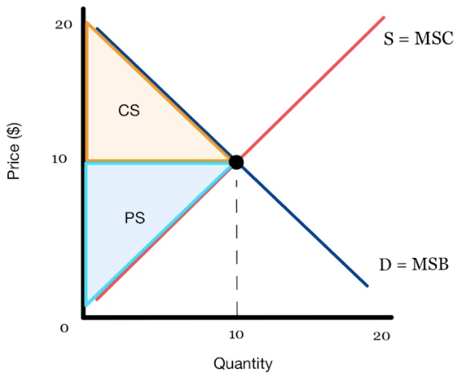
Optimal Social Quantity
Equilibirum
MSB = MSC
Copyright Bananaomics

Slide 7
Optimal Social Quantity
New terms to know
Merit Goods
Goods that are beneficial to the individual and society as a whole and are usually, under-provided.
Demerit Goods
Goods that are harmful to the individual and society as a whole and are usually, over-provided.
Copyright Bananaomics

Slide 8
Externalities
When third parties, who are uninvolved, are affected by the benefits and costs involved in producing or consuming a particular good.
Brainstorm with a partner or small group a list of 5 externalities in the real world
Copyright Bananaomics

Slide 9
Four Types of Externalities
Negative externalities of production
Positive externalities of production
MSC > MSB
MSC < MSB
Negative externalities of consumption
Positive externalities of consumption
MSC > MSB
MSC < MSB
Copyright Bananaomics

Slide 10
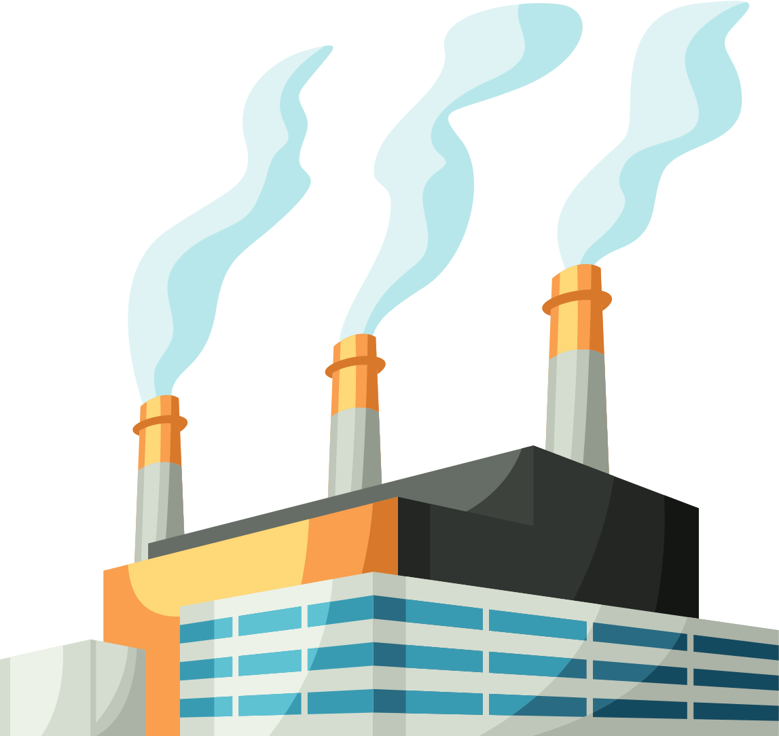
Negative Externality of Production
The production process of a good or service generates a negative effect on a third party or on society as a whole.
Private firms do not take the additional costs on society into consideration during production.
Examples
Air Pollution
Water Pollution
Loud noises generated.
Copyright Bananaomics

Slide 11
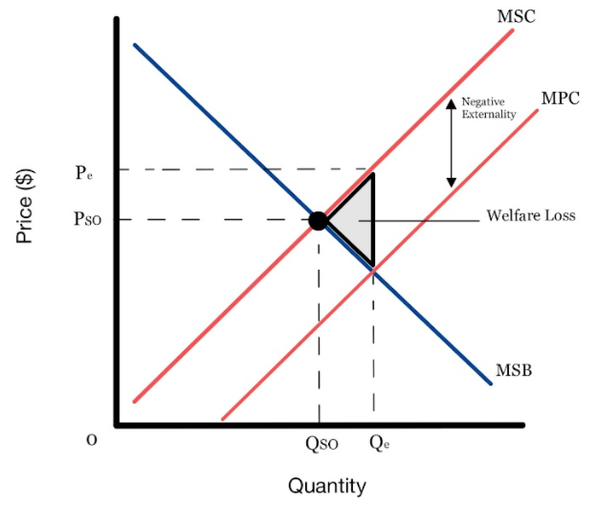
Negative Externality of Production
In the graph below, a typical company is making coal and is a significant contributor to air pollution in the area.
The firm will only take into consideration their private benefit and costs when determining how much to produce. The cost to society is much higher.
ATTENTION:
Notice that the negative externality only affects production (supply curve).
The demand curve represents both MSB + MPB.
Production externalities ALWAYS affect Cost/Supply
Copyright Bananaomics

Slide 12
Government Responses
The goal is to limit or decrease the production.
Legislation
Pass laws regarding environmental standards that firms must comply with. (Machinery upgrades, air filters, disposal requirements)
Pros: Easy to Apply
Cons: Cost of production increases -> unemployment potential, cost of enforcing policy
Carbon Tax
Impose a tax on the firm per unit of output produced.
Pros: Government Revenue, Easy to Apply
Cons: Difficult to measure, Difficult to calculate tax
Tradable Emission Permits
Permission to pollute permits that enforce a quota of emissions. An eco-friendly firm can sell its permit for profit.
Pros: Encourages firms to lower cost, free-market sets price of a permit, cooperation among businesses
Cons: Difficult to set an acceptable level of pollution, Difficult to measure pollution
Copyright Bananaomics

Slide 13
Positive Externality of Production
The production process of a good or service generates a positive effect on a third party or on society as a whole.
Examples
Research and Development of New Tech (BlockChain)
Bee Keeping
Flood Defence Systems
Copyright Bananaomics

Slide 14
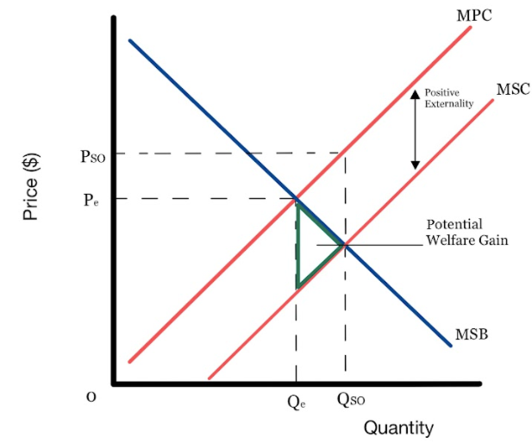
Positive Externality of Production
Due to it's a positive effect on society, MSC is less than than MPC.
Please note: This is still an inefficient allocation of resources but, a potential welfare gain.
Once again, production externalities ALWAYS affect costs/supply.
Copyright Bananaomics

Slide 15
Government Responses
The goal is to increase the production for the benefit of society.
Subsidizing Firms
Pros: Encourages promotion of the industry and lowers costs for firms.
Cons: The opportunity cost of using government funds, (may have to give up other things such as healthcare)
Direct Government Provision
Pros: Government is in full control
Cons: High costs and opportunity cost, lack of expertise by the government, private firms discouraged from joining market
Copyright Bananaomics

Slide 16
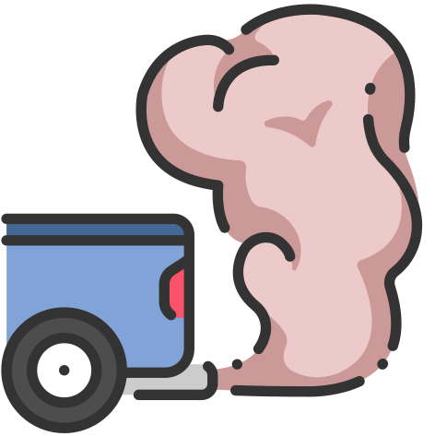
Negative Externality of Consumption
The consumption of a good or service generates a negative effect on a third party or on society as a whole.
Examples
Smoking cigarettes around others
Dog Ownership in Apartments
Driving Vehicles with High Emissions
Copyright Bananaomics

Slide 17
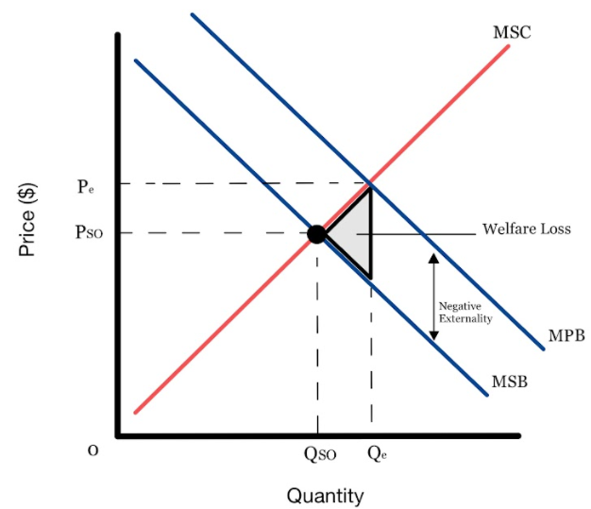
Negative Externality of Consumption
Due to its negative effect on society, MSB is lower than MPB. Consumption is greater than what it SHOULD BE. The good is over-allocated.
ATTENTION
Externalities of consumption focus on Demand/Benefits.
Therefore, MSC and MPC will always be equal.
Copyright Bananaomics

Slide 18
Government Responses
The goal is to decrease consumption for the benefit of society.
Indirect Taxes
Taxes designed to correct negative externalities are called Pigouvian Taxes
Pros: Increases the cost of the good quickly, Government Revenue
Cons: Addictive goods are demand price inelastic, creates black markets
Regulation or Ban
A regulation or full ban to make the product illegal. (Non-smoking Areas)
Pros: Reduce Demand, low cost
Cons: Slow to implement, Government Spending, Enforcing regulations, anger from consumers regarding free-will.
Negative Advertising
Government could fund negative advertising such as images on packs of cigarettes.
Pros: Aims to reduce demand naturally
Cons: High cost and opportunity costs for the government, studies are unclear on how effective advertising is especially on young adults and teenagers.
Copyright Bananaomics

Slide 19
Positive Externality of Consumption
The consumption of a good or service generates a positive effect on a third party or on society as a whole.
Examples
Education
Healthcare
Vaccines
Copyright Bananaomics

Slide 20
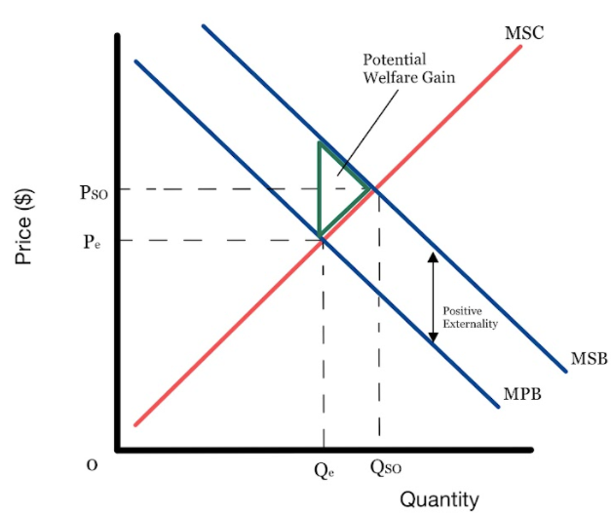
Positive Externality of Consumption
Due to its positive effect on society, MSB is greater than MPB. Consumption is SMALLER than it should be.
Please note: This is still an inefficient allocation of resources but, a potential welfare gain.
Once again, consumption externalities ALWAYS affect Demand/Benefits.
Copyright Bananaomics

Slide 21
Government Responses
The goal is to increase the consumption for the benefit of society.
Subsidizing Firms
Pros: Encourages promotion of the industry and lowers costs for firms.
Cons: The opportunity cost of using government funds, (may have to give up other things such as healthcare)
Direct Government Provision
Pros: Government is in full control
Cons: High costs and opportunity cost, lack of expertise by the government, private firms discouraged from joining market
Positive Advertisements
Pros: Aim to increase Demand Naturally
Cons: High costs and opportunity cost
Compulsory Legislation
Pros: Shifts demand effectively
Cons: Government must provide for free, anger from residents, cost of enforcing law
Copyright Bananaomics

Slide 22
Real World Connection
Vaccine Mandate
Copyright Bananaomics

Slide 23
Vaccine Mandates
Read the following article or Listen and answer the questions below with your group.
What are your initial thoughts on COVID vaccine mandates?
Explain the economic rationale for or against them
Do you think COVID vaccine mandate are legal? Would you support them?
Copyright Bananaomics

Slide 24
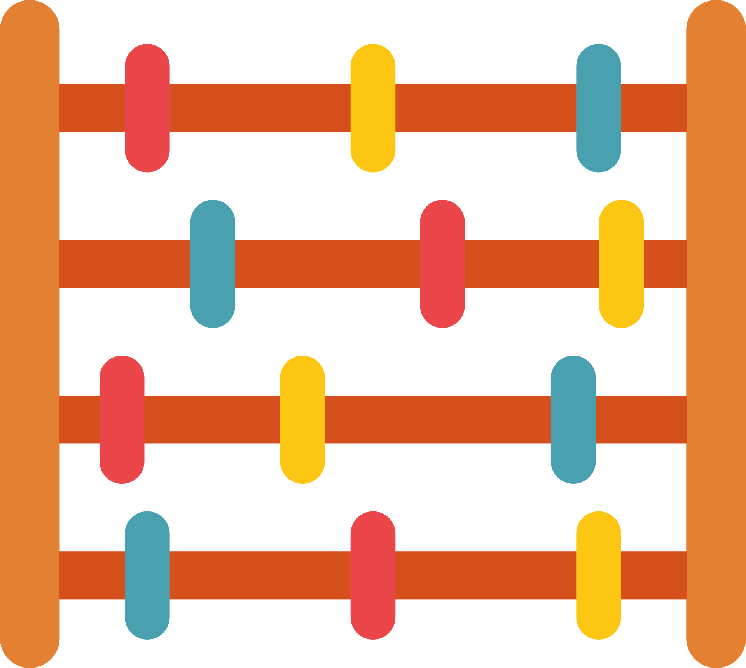
Welfare Loss/Gain Calculation
Copyright Bananaomics

Slide 25
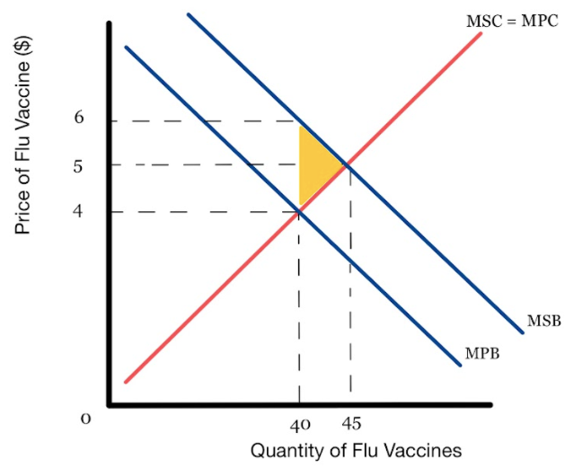
Welfare Gain/Loss Calculation
Area of a Triangle = 1/2 (base x height)
Determine whether this is a welfare gain or loss.
Calculate the amount in Euro. (note the quantity units) Show all work.
Copyright Bananaomics

Slide 26
Welfare Gain/Loss Calculation
Area of a Triangle = 1/2 (base x height)
Welfare Gain
Potential Welfare Gain = 1/2(base*height)
1/2((6-4)*5Million)
1/2( 2 * 5 Million)
1/2(10 Million)
Potential Welfare Gain = EUR 5 Million
Copyright Bananaomics

Slide 27
Common Pool Resources
Copyright Bananaomics

Slide 28
Common Pool Resources
Also known as Common Access Resources or Common Property Resources
Definition
Resources that are rivalrous but non-excludable.
Examples: Fish, Clean Air, Lakes/Rivers, Forest, Fertile Soil
Rivalrous
A good when consumed, cannot be consumed by another person.
Example
When one uses fertile soil, there are fewer spots for others to farm.
Non-Excludable
A good that someone cannot be excluded or prevented from using.
Example
Goods that have no price and are available to use without payment. Clean Air
Copyright Bananaomics

Slide 29
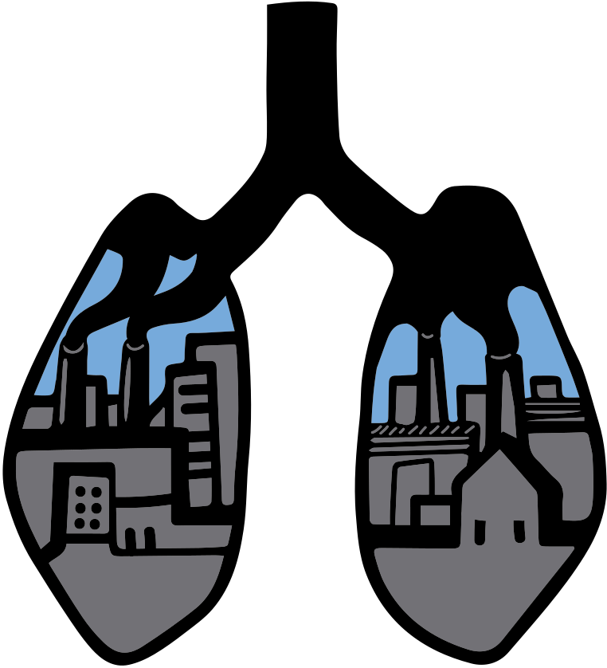
Common Pool Resources
Common Pool Resources are rivalrous and non-excludable.
It would be very difficult to charge a price for these items resulting in overuse and over-consumption which could lead to severe environmental impacts in the long run.
Copyright Bananaomics

Slide 30
Sustainability
Issues surrounding Common Pool Resources lead to discussions about Sustainability.
Definition
the ability of the present generation to meet its needs without compromising the ability of future generations to meet their own needs.
Copyright Bananaomics

Slide 31
Government Responses to Sustainability Threats
Sustainability is of great importance on a national and global level. These resources are not owned by one country, and therefore, international cooperation is key.
Some Examples
Carbon Emission Caps and Taxes
Subsidies for Clean and Renewable Technologies (Clean Technology)
Collective Self Governance
Participation of industries in the measures planned and taken to resolve environmental sustainability issues. These industries are aware there is a problem and strive to fix them.
Examples: Cruise Lines are aware they have a negative impact on the environment. They chose to implement and market their sustainability.
Copyright Bananaomics

Slide 32
International Cooperation
Copyright Bananaomics

Slide 33
International Cooperation
Countries must cooperate to develop, set, and enforce policies designed to slow, halt, and reverse climate change.
Example: Paris Climate Accord
Copyright Bananaomics

Slide 34
International Cooperation Challenges
Lack of Shared Responsibility
Not all countries produce large CO2 Emissions. The countries most affected are small islands with little/no C02 footprint while those larger countries responsible for large emissions are slow to act.
Inequality of Resources
Not all countries have the ability to devote resources to combat climate change. Developing countries find it much more difficult to transition to clean technology and renewable energy
Political Disagreements
Some governments are more committed than others to reducing environmental impacts and there are different views about which methods are best.
Copyright Bananaomics

Slide 35
Review
Copyright Bananaomics

Slide 36
Diagrams and Rationale
Concepts of MSB, MPB, MSC, MPC
Over-production vs under-production
Socially Optimal Quantity
Negative Externalities of Production and Consumption
Draw Diagrams, explain welfare loss/gain, and government responses
Positive Externalities of Production and Consumption
Draw Diagrams, explain welfare loss/gain, and government responses
Copyright Bananaomics

Slide 37
Practice Question
Copyright Bananaomics

Slide 38
Paper 1
M13/3/ECONO/SP1/ENG/TZ1/XX
Copyright Bananaomics

Slide 39
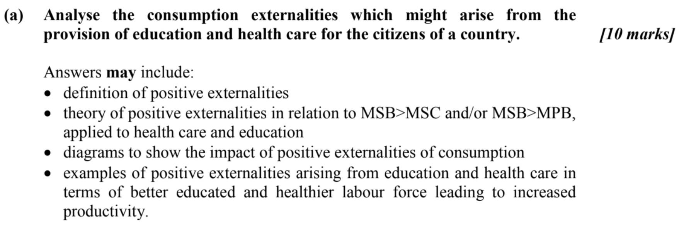
Check Answers
Copyright Bananaomics

Slide 40
Enjoying The Content?
Visit bananaomics.com to purchase package deals with discount prices!
BANANAOMICS

